Slide 1
Case: Retail Analytics for a Specialty Retail Store

Slide 2
Agenda
Exploratory data analysis
Converting a “Transaction dataset” to “Customer dataset” using Recency (R), Frequency (F) and Monetary Value (M)
Building Segments by RFM – Cluster Analysis: “Statistical Segmentation”
Building Segments by RFM Scoring method
Building Segments using domain rules: “Managerial Segmentation”
Doing the managerial segmentation till 2014 and then seeing how the segments behaved in 2015
Calculating future Cash Flows using Loyalty matrix & Revenue
Computing the CLV and the X-times worth of the firm

Slide 3
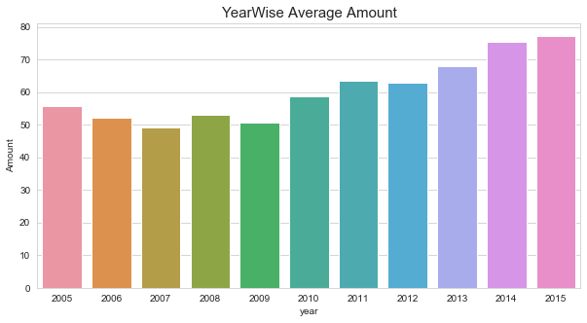
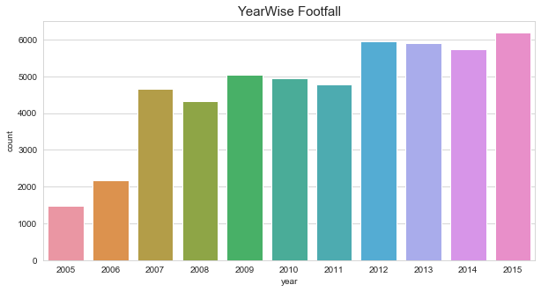
Exploratory Data Analysis
• The dataset contains transaction details of a stationary shop occurring between 2005-01-02 and 2015-12-31 • No. of transactions : 51243 • No. of features: 3
Customer ID
Bill Amount
Transaction Date
Number of transactions Year wise
Yearly average bill amount

Slide 4

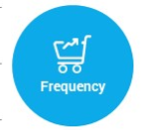
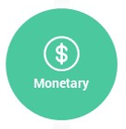
A Customer Segmentation was done on R, F, M
Recency - How much time has elapsed since a customer’s last activity or transaction?
Frequency - How often has a customer transacted or interacted during a particular period of time?
Monetary value: Reflects how much a customer has spent, on average, during a particular period of time

Slide 5
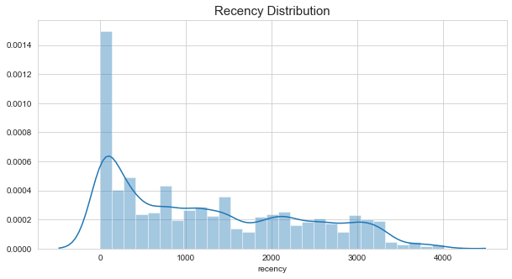
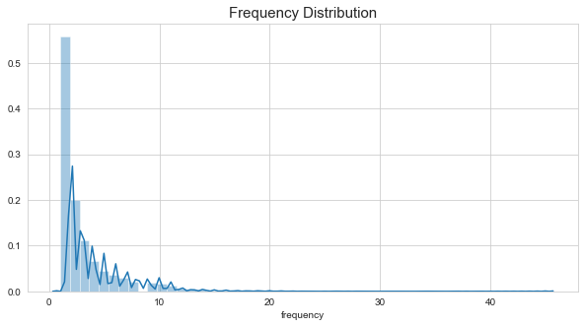
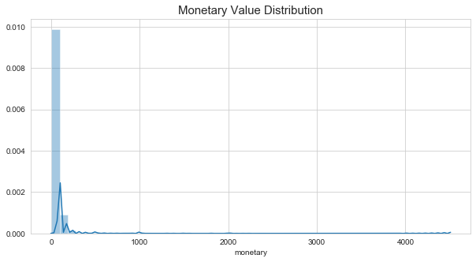
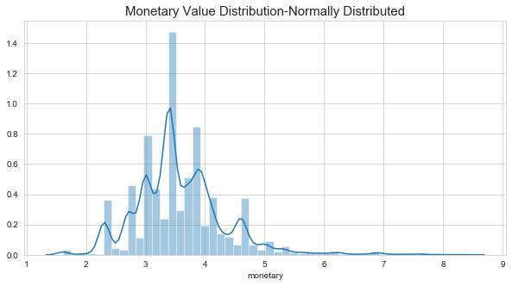
Frequency distribution of Recency Attribute
Distribution of Frequency Attribute
LOG TRANSFORM
Frequency distribution of Monetary Value

Slide 6
Segments characteristics: 9-Cluster Solution
Cluster no. | Size | Recency (in days) | Frequency | Amount (in $)
1 | 16% | 2563 | 1.3 | 37.78
2 | 11% | 2604 | 1.3 | 16.26
3 | 10% | 194 | 10.6 | 42.01
4 | 16% | 162 | 2.4 | 41.10
5 | 2% | 2567 | 1.9 | 214.10
6 | 4% | 419 | 6.5 | 261.21
7 | 12% | 1144 | 4.1 | 29.85
8 | 17% | 923 | 1.3 | 22.45
9 | 11% | 799 | 1.1 | 87.42

Slide 7
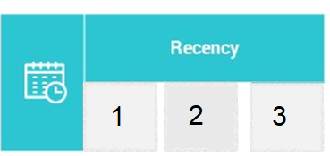
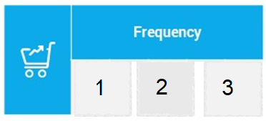
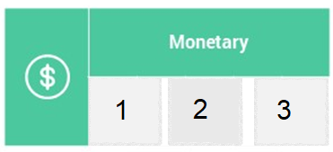
RFM Analysis – Scoring Methods
Recency is a score between 1 and 3, 3 being the most recent and 1 being the least recent. Recency is significant because it defines customer’s interaction
Frequency is a score between 1 and 3, 3 being the highest frequency of orders and 1 being just 1 visit. It’s the number of visit the customer made
Monetary is also a score between 1 and 3, 3 being the most amount spend and 1 being the lowest spending.

Slide 8
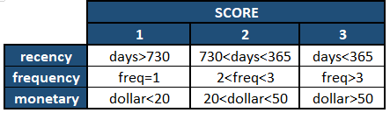
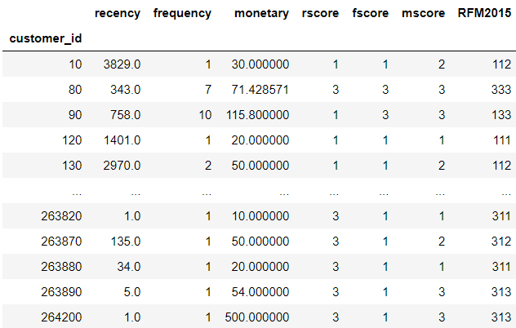
Segments by RFM Scoring
_____________________________________RFM Score = R*100 + F*10 + M*1
RFM Score will range from 111 to 333
_____________________________________

Slide 9
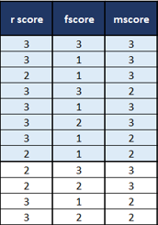
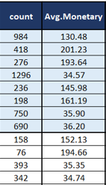

Segments by RFM Scoring
_____________________________________
SEGMENTATION BASED ON SALES AMOUNT
_____________________________________

Slide 10
We then moved to “domain rules” to get into a “Managerial Segmentation”
Segments | Definition
Inactive | Recency > 1095 days
Cold | 1095 days > Recency > 730 days
Warm high value | 730 days > Recency > 365 days | and | Monetary value >$100
Warm low value | 730 days > Recency > 365 days | and | Monetary value<$100
New warm | 730 days > Recency > 365 days | and | First purchase in 365 – 730 days
Active high value | Recency <= 365 days | and | Monetary value> $100
Active low value | Recency <=365 days | and | Monetary value<$100
New active | Recency <= 365 days | and | First purchase <= 365 days

Slide 11
Segments by Recency

Slide 12
Managerial Segments

Slide 13
CLV computation with our Retail dataset
“Managerial” segments are created taking the data till 2014
Buying behavior of the customers in 2015 are seen for every segment in 2014
Accordingly, movements of customers from one segment (in 2014) to another (in 2015) are calculated [SEGMENT TRANSITION]

Slide 14
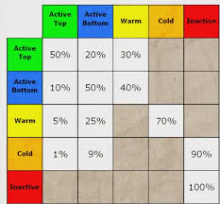
An example of Segment Transition from 2014 to 2015
CURRENT YEAR (2015)
TILL PREVIOUS YEAR (2014)

Slide 15
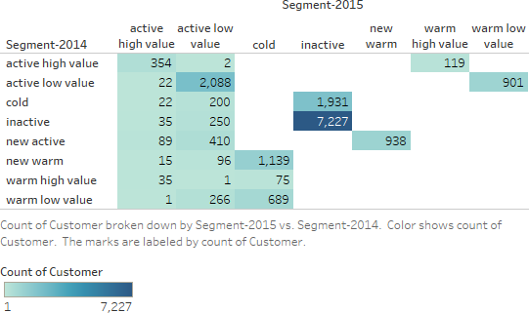
Segment Transition from 2014 to 2015

Slide 16
How the segments would evolve over the next yrs
 | 2015 | 2016 | 2017 | 2018 | 2019 | 2020 | 2021 | 2022 | 2023 | 2024 | 2025
Inactive | 9158 | 10517 | 11539 | 12636 | 12940 | 13186 | 13386 | 13542 | 13664 | 13759 | 13834
Cold | 1903 | 1584 | 1711 | 874 | 821 | 782 | 740 | 709 | 684 | 665 | 650
Warm high value | 119 | 144 | 165 | 160 | 156 | 152 | 149 | 146 | 143 | 141 | 139
Warm low value | 901 | 991 | 1058 | 989 | 938 | 884 | 844 | 813 | 789 | 771 | 756
New warm | 938 | 987 | 0 | 0 | 0 | 0 | 0 | 0 | 0 | 0 | 0
Active high value | 573 | 657 | 639 | 624 | 607 | 593 | 581 | 571 | 562 | 554 | 547
Active low value | 3313 | 3537 | 3305 | 3134 | 2954 | 2820 | 2717 | 2637 | 2575 | 2527 | 2490
New active | 1512 | 0 | 0 | 0 | 0 | 0 | 0 | 0 | 0 | 0 | 0

